Slide 1
Distributed software engineering
Lecture 23
Based on 17th Chapter Software Engineering Ian Sommerville 10th Edition

Slide 2
Topics covered
Distributed systems
Client–server computing
Architectural patterns for distributed systems
Software as a service

Slide 3
Distributed systems
Virtually all large computer-based systems are now
distributed systems.
“… a collection of independent computers that appears to the user as a single coherent system.”
Information processing is distributed over several
computers rather than confined to a single machine.
Distributed software engineering is therefore very important for enterprise computing systems.

Slide 4
Distributed system characteristics
Resource sharing
Sharing of hardware and software resources.
Openness
Use of equipment and software from different vendors.
Concurrency
Concurrent processing to enhance performance.
Scalability
Increased throughput by adding new resources.
Fault tolerance
The ability to continue in operation after a fault has occurred.

Slide 5
Distributed systems

Slide 6
Distributed systems issues
Distributed systems are more complex than systems that
run on a single processor.
Complexity arises because different parts of the system are independently managed as is the network.
There is no single authority in charge of the system so top-down control is impossible.

Slide 7
Design issues
Transparency To what extent should the distributed system appear
to the user as a single system?
Openness Should a system be designed using standard protocols that support interoperability?
Scalability How can the system be constructed so that it is
scaleable?
Security How can usable security policies be defined and implemented?
Quality of service How should the quality of service be specified.
Failure management How can system failures be detected, contained and repaired?

Slide 8
Transparency
Ideally, users should not be aware that a system is distributed and services should be independent of distribution characteristics.
In practice, this is impossible because parts of the system are independently managed and because of network delays.
Often better to make users aware of distribution so that they can cope with problems
To achieve transparency, resources should be abstracted and addressed logically rather than physically. Middleware maps logical to physical resources.

Slide 9
Openness
Open distributed systems are systems that are built
according to generally accepted standards.
Components from any supplier can be integrated into the system and can inter-operate with the other system components.
Openness implies that system components can be independently developed in any programming language and, if these conform to standards, they will work with other components.
Web service standards for service-oriented architectures were developed to be open standards.

Slide 10
Scalability
The scalability of a system reflects its ability to deliver a
high quality service as demands on the system increase
Size It should be possible to add more resources to a system to cope with increasing numbers of users.
Distribution It should be possible to geographically disperse the
components of a system without degrading its performance.
Manageability It should be possible to manage a system as it increases in size, even if parts of the system are located in independent organizations.
There is a distinction between scaling-up and scaling- out. Scaling up is more powerful system; scaling out is more system instances.

Slide 11
Security
When a system is distributed, the number of ways that the system may be attacked is significantly increased, compared to centralized systems.
If a part of the system is successfully attacked then the attacker may be able to use this as a ‘back door’ into other parts of the system.
Difficulties in a distributed system arise because different organizations may own parts of the system. These organizations may have mutually incompatible security policies and security mechanisms.

Slide 12
Types of attack
The types of attack that a distributed system must
defend itself against are:
Interception, where communications between parts of the system are intercepted by an attacker so that there is a loss of confidentiality.
Interruption, where system services are attacked and cannot be delivered as expected.
Denial of service attacks involve bombarding a node with illegitimate service requests so that it cannot deal with valid requests.
Modification, where data or services in the system are changed
by an attacker.
Fabrication, where an attacker generates information that should not exist and then uses this to gain some privileges.

Slide 13
Quality of service
The quality of service (QoS) offered by a distributed system reflects the system’s ability to deliver its services dependably and with a response time and throughput that is acceptable to its users.
Quality of service is particularly critical when the system is dealing with time-critical data such as sound or video streams.
In these circumstances, if the quality of service falls below a threshold value then the sound or video may become so degraded that it is impossible to understand.

Slide 14
Failure management
In a distributed system, it is inevitable that failures will occur, so the system has to be designed to be resilient to these failures.
“You know that you have a distributed system when the crash of a system that you’ve never heard of stops you getting any work done.”
Distributed systems should include mechanisms for discovering if a component of the system has failed, should continue to deliver as many services as possible in spite of that failure and, as far as possible, automatically recover from the failure.

Slide 15
Models of interaction
Two types of interaction between components in a
distributed system
Procedural interaction, where one computer calls on a known service offered by another computer and waits for a response.
Message-based interaction, involves the sending computer sending information about what is required to another computer. There is no necessity to wait for a response.

Slide 16






























Procedural interaction between a diner and a waiter

Slide 17
Message-based interaction between a waiter and the kitchen
<starter>
<dish name = “soup” type = “tomato” />
<dish name = “soup” type = “fish” />
<dish name = “pigeon salad” />
</starter>
<main course>
<dish name = “steak” type = “sirloin” cooking = “medium” />
<dish name = “steak” type = “fillet” cooking = “rare” />
<dish name = “sea bass”>
</main>
<accompaniment>
<dish name = “french fries” portions = “2” />
<dish name = “salad” portions = “1” />
</accompaniment>

Slide 18
Remote procedure calls
Procedural communication in a distributed system is
implemented using remote procedure calls (RPC).
In a remote procedure call, one component calls another component as if it was a local procedure or method. The middleware in the system intercepts this call and passes it to a remote component.
This carries out the required computation and, via the middleware, returns the result to the calling component.
A problem with RPCs is that the caller and the callee need to be available at the time of the communication, and they must know how to refer to each other.

Slide 19
Message passing
Message-based interaction normally involves one component creating a message that details the services required from another component.
Through the system middleware, this is sent to the receiving component.
The receiver parses the message, carries out the computations and creates a message for the sending component with the required results.
In a message-based approach, it is not necessary for the sender and receiver of the message to be aware of each other. They simple communicate with the middleware.

Slide 20
Middleware
The components in a distributed system may be implemented in different programming languages and may execute on completely different types of processor. Models of data, information representation and protocols for communication may all be different.
Middleware is software that can manage these diverse parts, and ensure that they can communicate and exchange data.

Slide 21
























Middleware in a distributed system

Slide 22
Middleware support
Interaction support, where the middleware coordinates
interactions between different components in the system
The middleware provides location transparency in that it isn’t necessary for components to know the physical locations of other components.
The provision of common services, where the middleware provides reusable implementations of services that may be required by several components in the distributed system.
By using these common services, components can easily inter- operate and provide user services in a consistent way.

Slide 23
Client-server computing

Slide 24
Client-server computing
Distributed systems that are accessed over the Internet
are normally organized as client-server systems.
In a client-server system, the user interacts with a program running on their local computer (e.g. a web browser or mobile application). This interacts with another program running on a remote computer (e.g. a web server).
The remote computer provides services, such as access
to web pages, which are available to external clients.

Slide 25
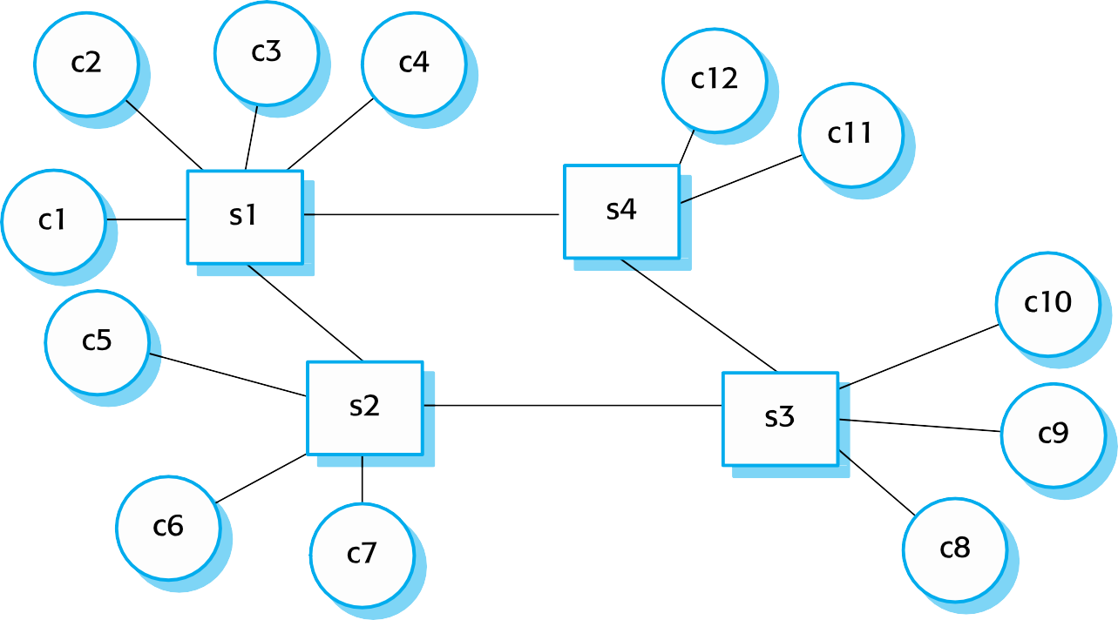
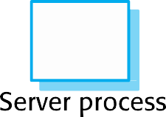

Client–server interaction

Slide 26


Mapping of clients and servers to networked computers

Slide 27









Layered architectural model for client–server applications

Slide 28
Layers in a client/server system
Presentation
concerned with presenting information to the user and managing all user interaction.
Data handling
manages the data that is passed to and from the client.
Implement checks on the data, generate web pages, etc.
Application processing layer
concerned with implementing the logic of the application and so
providing the required functionality to end users.
Database
Stores data and provides transaction management services, etc.

Slide 29
Architectural patterns
Widely used ways of organizing the architecture of a distributed
system:
Master-slave architecture, which is used in real-time systems in which guaranteed interaction response times are required.
Two-tier client-server architecture, which is used for simple client-server
systems, and where the system is centralized for security reasons.
Multi-tier client-server architecture, which is used when there is a high volume of transactions to be processed by the server.
Distributed component architecture, which is used when resources from different systems and databases need to be combined, or as an implementation model for multi-tier client-server systems.
Peer-to-peer architecture, which is used when clients exchange locally stored information and the role of the server is to introduce clients to each other

Slide 30
Master-slave architectures
Master-slave architectures are commonly used in real- time systems where there may be separate processors associated with data acquisition from the system’s environment, data processing and computation and actuator management.
The ‘master’ process is usually responsible for computation, coordination and communications and it controls the ‘slave’ processes.
‘Slave’ processes are dedicated to specific actions, such as the acquisition of data from an array of sensors.

Slide 31
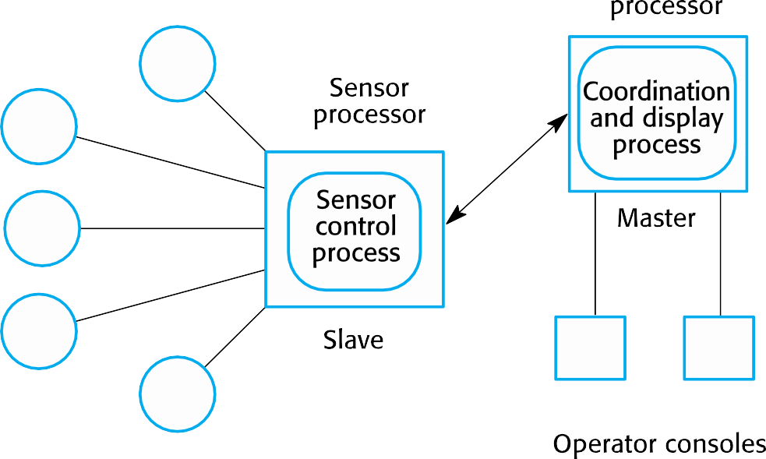
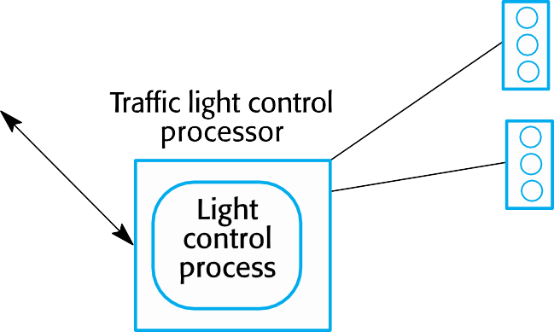















A traffic management system with a master- slave architecture

Slide 32
Two-tier client server architectures
In a two-tier client-server architecture, the system is implemented as a single logical server plus an indefinite number of clients that use that server.
Thin-client model, where the presentation layer is implemented on the client and all other layers (data management, application processing and database) are implemented on a server.
Fat-client model, where some or all of the application processing is carried out on the client. Data management and database functions are implemented on the server.

Slide 33
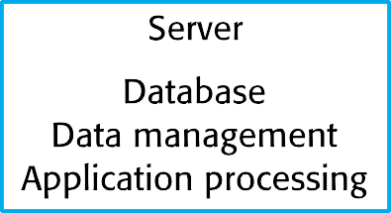


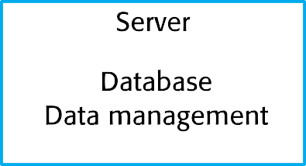
Thin- and fat-client architectural models

Slide 34
Thin client model
Used when legacy systems are migrated to client server
architectures.
The legacy system acts as a server in its own right with a graphical interface implemented on a client.
A major disadvantage is that it places a heavy
processing load on both the server and the network.

Slide 35
Fat client model
More processing is delegated to the client as the
application processing is locally executed.
Most suitable for new C/S systems where the capabilities of the client system are known in advance.
More complex than a thin client model especially for management. New versions of the application have to be installed on all clients.

Slide 36









A fat-client architecture for an ATM system

Slide 37
Thin and fat clients
Distinction between thin and fat client architectures has
become blurred
Javascript allows local processing in a browser so ‘fat- client’ functionality available without software installation
Mobile apps carry out some local processing to minimize demands on network
Auto-update of apps reduces management problems
There are now very few thin-client applications with all processing carried out on remote server.

Slide 38
Multi-tier client-server architectures
In a ‘multi-tier client–server’ architecture, the different layers of the system, namely presentation, data management, application processing, and database, are separate processes that may execute on different processors.
This avoids problems with scalability and performance if a thin-client two-tier model is chosen, or problems of system management if a fat-client model is used.

Slide 39
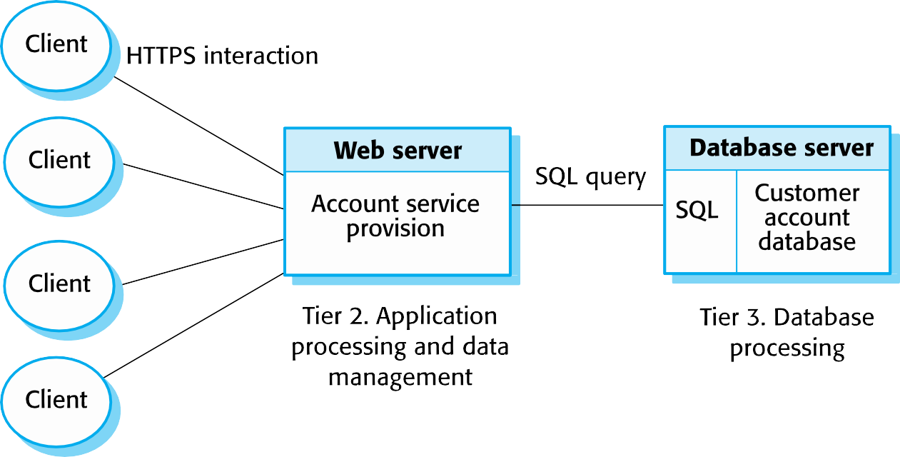
Three-tier architecture for an Internet banking system

Slide 40
Use of client–server architectural patterns
Architecture | Applications
Two-tier client–server architecture with thin clients | Legacy system applications that are used when separating application processing and data management is impractical. Clients may access these as services, as discussed in Section 18.4. Computationally intensive applications such as compilers with little or no data management. Data-intensive applications (browsing and querying) with nonintensive application processing. Browsing the Web is the most common example of a situation where this architecture is used.

Slide 41
Use of client–server architectural patterns
Architecture | Applications
Two-tier client-server architecture with fat clients | Applications where application processing is provided by off-the-shelf software (e.g., Microsoft Excel) on the client. Applications where computationally intensive processing of data (e.g., data visualization) is required. Mobile applications where internet connectivity cannot be guaranteed. Some local processing using cached information from the database is therefore possible.
Multi-tier client–server architecture | Large-scale applications with hundreds or thousands of clients. Applications where both the data and the application are volatile. Applications where data from multiple sources are integrated.

Slide 42
Distributed component architectures
There is no distinction in a distributed component
architecture between clients and servers.
Each distributable entity is a component that provides services to other components and receives services from other components.
Component communication is through a middleware system.

Slide 43
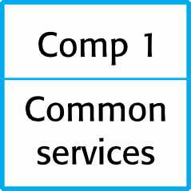
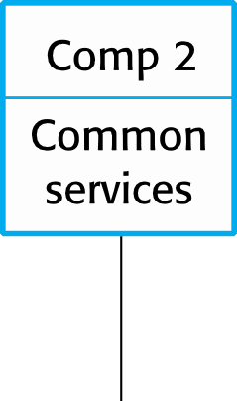
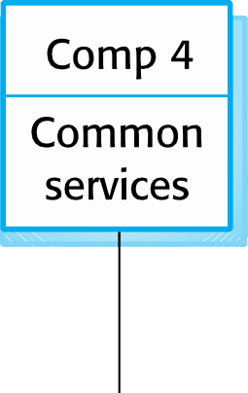
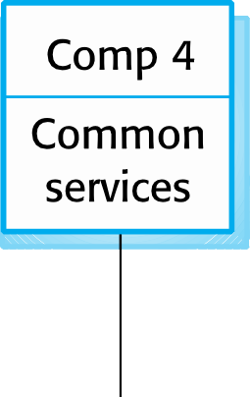







A distributed component architecture

Slide 44
Benefits of distributed component architecture
It allows the system designer to delay decisions on
where and how services should be provided.
It is a very open system architecture that allows new resources to be added as required.
The system is flexible and scalable.
It is possible to reconfigure the system dynamically with objects migrating across the network as required.

Slide 45


A distributed component architecture for a data mining system

Slide 46
Disadvantages of distributed component architecture
Distributed component architectures suffer from two
major disadvantages:
They are more complex to design than client–server systems. Distributed component architectures are difficult for people to visualize and understand.
Standardized middleware for distributed component systems has never been accepted by the community. Different vendors, such as Microsoft and Sun, have developed different, incompatible middleware.
As a result of these problems, service-oriented architectures are replacing distributed component architectures in many situations.

Slide 47
Peer-to-peer architectures
Peer to peer (p2p) systems are decentralised systems where computations may be carried out by any node in the network.
The overall system is designed to take advantage of the computational power and storage of a large number of networked computers.
Most p2p systems have been personal systems but there is increasing business use of this technology.

Slide 48
Peer-to-peer systems
File sharing systems based on the BitTorrent protocol
Messaging systems such as Jabber
Payments systems – Bitcoin
Databases – Freenet is a decentralized database
Phone systems – Viber
Computation systems - SETI@home

Slide 49
P2p architectural models
The logical network architecture
Decentralised architectures;
Semi-centralised architectures.
Application architecture
The generic organisation of components making up a p2p application.
Focus here on network architectures.

Slide 50
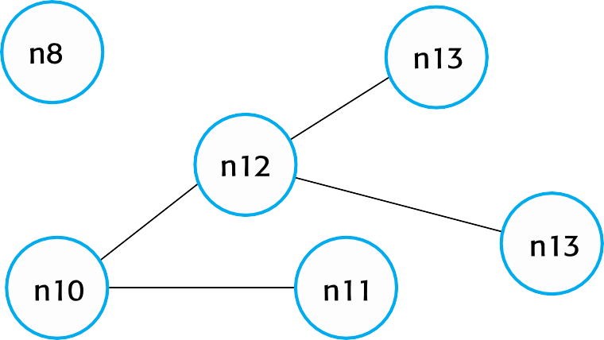
A decentralized p2p architecture

Slide 51
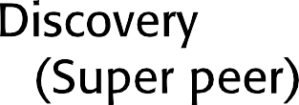
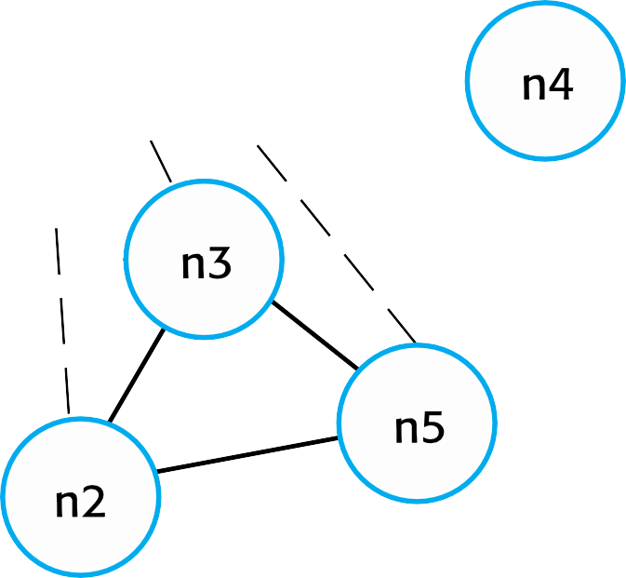
A semicentralized p2p architecture

Slide 52
Software as a service

Slide 53
Use of p2p architecture
When a system is computationally-intensive and it is possible to separate the processing required into a large number of independent computations.
When a system primarily involves the exchange of information between individual computers on a network and there is no need for this information to be centrally- stored or managed.

Slide 54
Security issues in p2p system
Security concerns are the principal reason why p2p
architectures are not widely used.
The lack of central management means that malicious nodes can be set up to deliver spam and malware to other nodes in the network.
P2P communications require careful setup to protect local information and if not done correctly, then this is exposed to othe peers.

Slide 55
Software as a service
Software as a service (SaaS) involves hosting the software remotely and providing access to it over the Internet.
Software is deployed on a server (or more commonly a number of servers) and is accessed through a web browser. It is not deployed on a local PC.
The software is owned and managed by a software provider, rather than the organizations using the software.
Users may pay for the software according to the amount of use
they make of it or through an annual or monthly subscription.

Slide 56
Key elements of SaaS
Software is deployed on a server (or more commonly a number of servers) and is accessed through a web browser. It is not deployed on a local PC.
The software is owned and managed by a software provider, rather than the organizations using the software.
Users may pay for the software according to the amount of use they make of it or through an annual or monthly subscription. Sometimes, the software is free for anyone to use but users must then agree to accept advertisements, which fund the software service.

Slide 57
SaaS and SOA
Software as a service is a way of providing functionality on a remote server with client access through a web browser. The server maintains the user’s data and state during an interaction session. Transactions are usually long transactions e.g. editing a document.
Service-oriented architecture is an approach to structuring a software system as a set of separate, stateless services. These may be provided by multiple providers and may be distributed. Typically, transactions are short transactions where a service is called, does something then returns a result.

Slide 58
Implementation factors for SaaS
Configurability How do you configure the software for the
specific requirements of each organization?
Multi-tenancy How do you present each user of the software with the impression that they are working with their own copy of the system while, at the same time, making efficient use of system resources?
Scalability How do you design the system so that it can be scaled to accommodate an unpredictably large number of users?

Slide 59
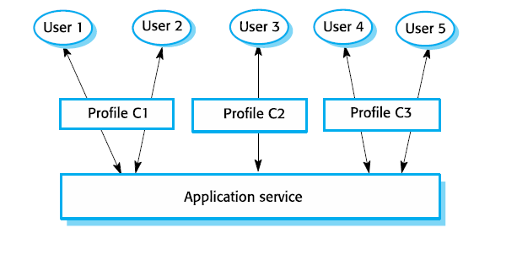
Configuration of a software system offered as a service

Slide 60
Service configuration
Branding, where users from each organization, are presented
with an interface that reflects their own organization.
Business rules and workflows, where each organization defines its own rules that govern the use of the service and its data.
Database extensions, where each organization defines how the generic service data model is extended to meet its specific needs.
Access control, where service customers create individual accounts for their staff and define the resources and functions that are accessible to each of their users.

Slide 61
Multi-tenancy
Multi-tenancy is a situation in which many different users access the same system and the system architecture is defined to allow the efficient sharing of system resources.
It must appear to each user that they have the sole use of the system.
Multi-tenancy involves designing the system so that there is an absolute separation between the system functionality and the system data.

Slide 62
Scalability
Develop applications where each component is implemented
as a simple stateless service that may be run on any server.
Design the system using asynchronous interaction so that the application does not have to wait for the result of an interaction (such as a read request).
Manage resources, such as network and database connections, as a pool so that no single server is likely to run out of resources.
Design your database to allow fine-grain locking. That is, do not lock out whole records in the database when only part of a record is in use.

Slide 63
Key points
The benefits of distributed systems are that they can be scaled to cope with increasing demand, can continue to provide user services if parts of the system fail, and they enable resources to be shared.
Issues to be considered in the design of distributed systems include transparency, openness, scalability, security, quality of service and failure management.
Client–server systems are structured into layers, with the presentation layer implemented on a client computer. Servers provide data management, application and database services.
Client-server systems may have several tiers, with different
layers of the system distributed to different computers.

Slide 64
Key points
Architectural patterns for distributed systems include master- slave architectures, two-tier and multi-tier client-server architectures, distributed component architectures and peer- to-peer architectures.
Distributed component systems require middleware to handle component communications and to allow components to be added to and removed from the system.
Peer-to-peer architectures are decentralized with no distinguished clients and servers. Computations can be distributed over many systems in different organizations.
Software as a service is a way of deploying applications as thin client- server systems, where the client is a web browser.

